Slide 1
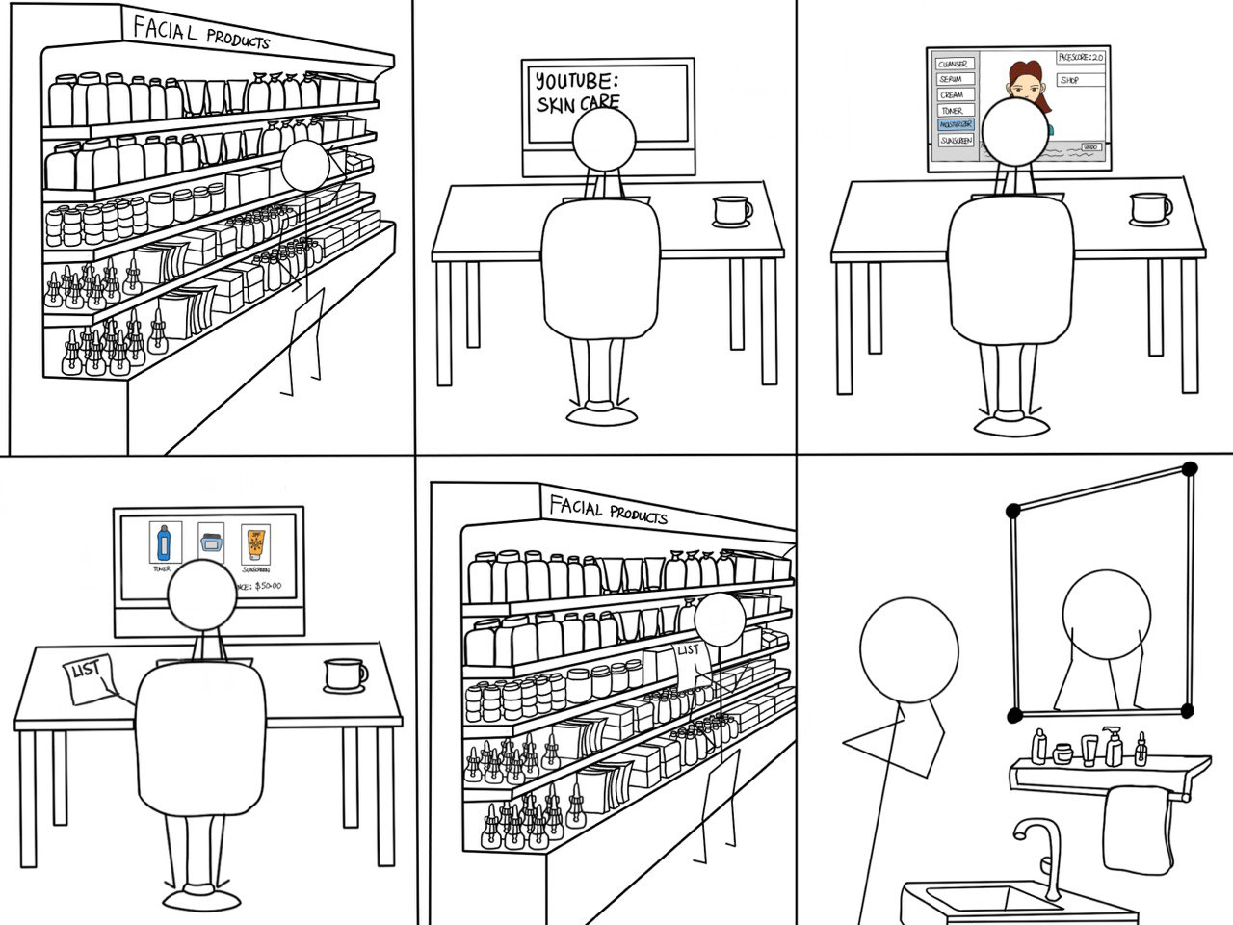
Hmm so he uses this web application called: “Glow-Up”
So many products, which one should I pick for my acne?
Let me watch a Youtuber on how he chooses his skincare products.
Thanks to the game “Glow-up”, I also know how I should apply these facial care products!
Now I know which products will increase my real-life face score!
Okay, so these products …

